Slide 1
Analysing the Heart Disease
Guided by- R. Raja Subramanyam
Presented by:
1.D.Sai Sujan-9919004070
2M.Prasanna-9919004001
3.D.Badhri-9919004060
4.D.Usha rani-9919004068

Slide 2
Abstract
Heart disease describes a range of conditions that affect your heart. Diseases under the heart disease umbrella include blood vessel diseases, such as coronary artery disease, heart rhythm problems (arrhythmias) and heart defects you’re born with (congenital heart defects), among others.
The term “heart disease” is often used interchangeably with the term “cardiovascular disease”. Cardiovascular disease generally refers to conditions that involve narrowed or blocked blood vessels that can lead to a heart attack, chest pain (angina) or stroke. Other heart conditions, such as those that affect your heart’s muscle, valves or rhythm, also are considered forms of heart disease.
Heart disease is one of the biggest causes of morbidity and mortality among the population of the world. Prediction of cardiovascular disease is regarded as one of the most important subjects in the section of clinical data analysis. The amount of data in the healthcare industry is huge. Data mining turns the large collection of raw healthcare data into information that can help to make informed decisions and predictions.
According to a news article, heart disease proves to be the leading cause of death for both women and men.

Slide 3
Data
There are 14 columns in the dataset, which are described below.
Age: displays the age of the individual.
Gender: displays the gender of the individual using the following format : 1 = male 0 = female
Chest_Pain: displays the type of chest-pain experienced by the individual using the following format : 0 = typical angina 1 = atypical angina 2 = non — anginal pain 3 = asymptotic
Resting_BP: displays the resting blood pressure value of an individual in mmHg (unit)
Cholesterol: displays the serum cholesterol in mg/dl (unit)
Fasting_BS: compares the fasting blood sugar value of an individual with 120mg/dl. If fasting blood sugar > 120mg/dl then : 1 (true) else : 0 (false)
RECG : displays resting electrocardiographic results 0 = normal 1 = having ST-T wave abnormality 2 = left ventricular hyperthrophy

Slide 4
Max_Heart_Rate : displays the max heart rate achieved by an individual.
Exercise_Ang : 1 = yes 0 = no
ST_Depression: displays the value which is an integer or float.
ST_Segmen : 0 = upsloping 1 = flat 2 = downsloping
: displays the thalassemia : 3 = normal 6 = fixed defect 7 = reversible defect
Diagnosis of heart disease(patient) : Displays whether the individual is suffering from heart disease or not : 0 = absence 1, 2, 3, 4 = present.
Thalassemia

Slide 5
Python Packages Used
os
pandas
numpy
matplotlib.pyplot
matplotlib
seaborn
datetime
seaborn
collections

Slide 6
Result
Results: Per the studies analyzed, Big Data analytics is useful in predicting heart attack, and the technologies used in Big Data are extremely vital to the management and tailoring of treatment for cardiovascular disease. And as the use of Big Data in healthcare increases, more useful personalized medicine will be available to individual patients.

Slide 7
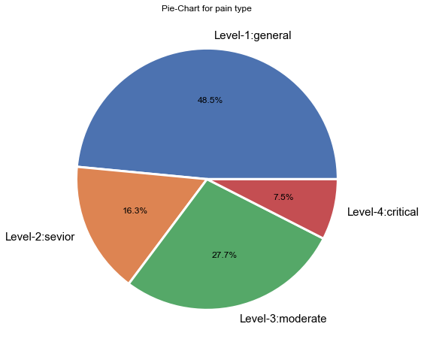
People with Level-1 Pain : 497 People with Level-2 Pain : 284 People with Level-3 Pain : 167 People with Level-4 Pain : 77 Percentage with Level-1 Pain : 48.48780487804878 % Percentage with Level-2 Pain : 16.29268292682927 % Percentage with Level-3 Pain : 27.70731707317073 % Percentage with Level-4 Pain : 7.512195121951219 %

Slide 8
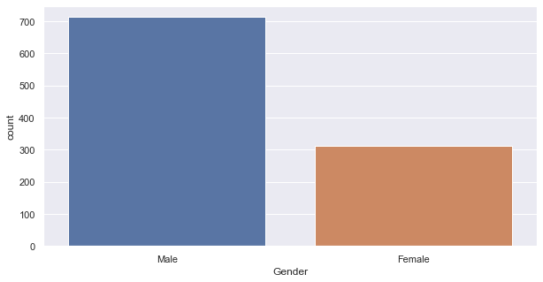
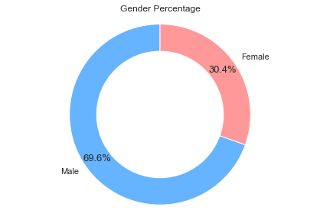
Total People: 1025
Total Male: 713
Total Female: 312
Percentage of Male: 69.5609756097561 % Percentage of Female: 30.4390243902439 %

Slide 9
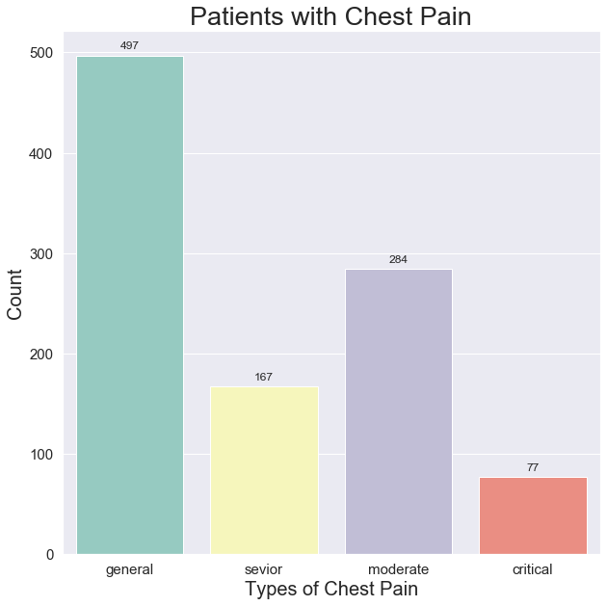
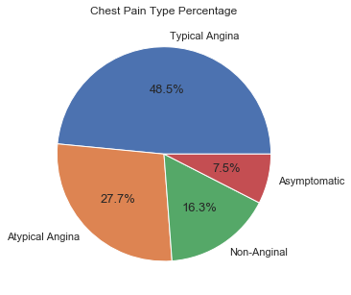
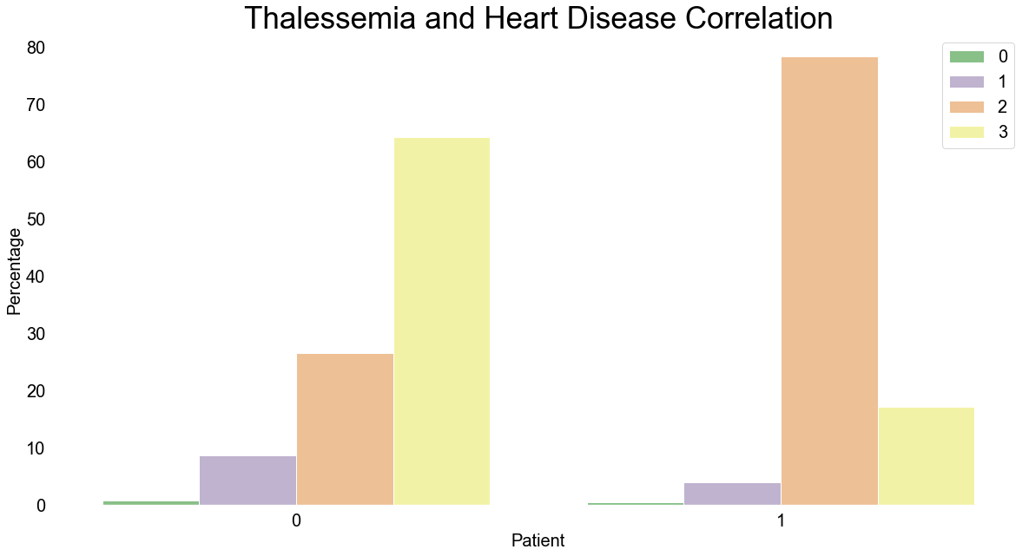
The given graph and pie chart shows the count of the patients and type of chest pain.
We can see that there are more number of patients with general type of chest pain(typical angina)
And with a less patients with critical chest pain(Asymptomatic).

Slide 10
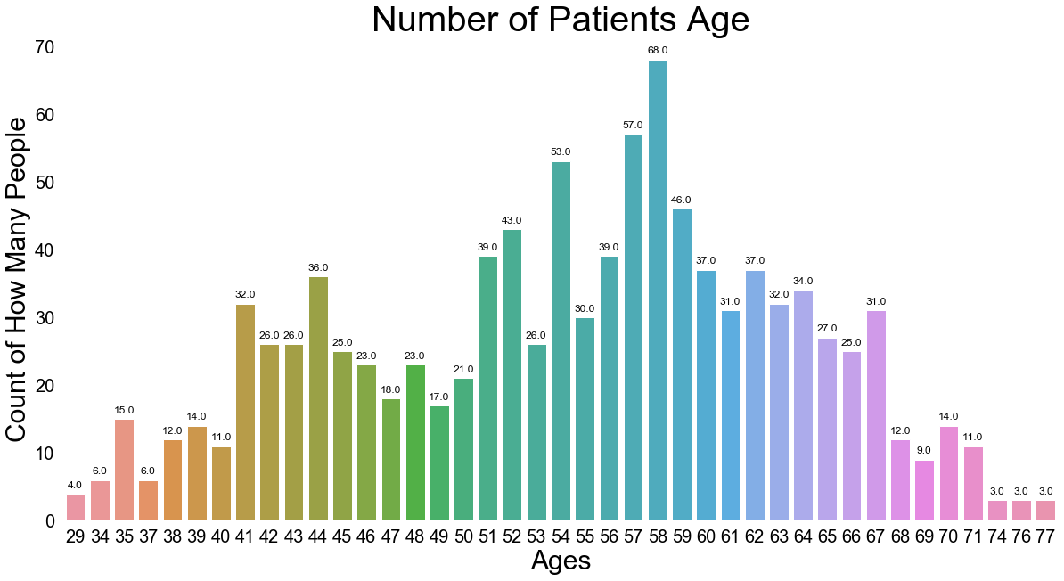
This graph compare the count of patients with their age.By this graph We see that most people who are suffering are suffering are of the age of 58followed by 57.Majorly people belonging to the age group of 50+ are suffering from the disease.

Slide 11
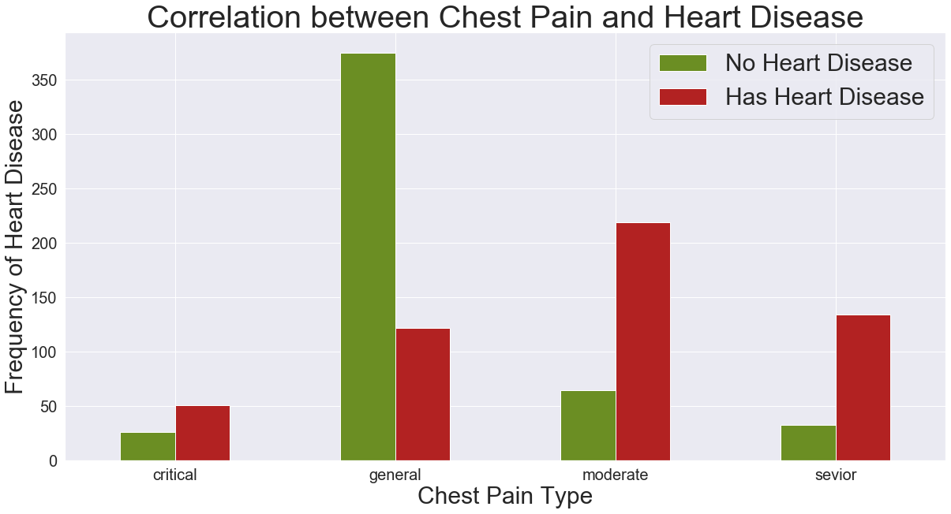
The given graph shows the correlation between chest pain and heart disease which has the graph between chest pain type and frequency of heart disease.The persons with general chest pain have a less possibility to have a heart disease.The remaining type of chest pains have a maximum possibility to get heart disease.

Slide 12
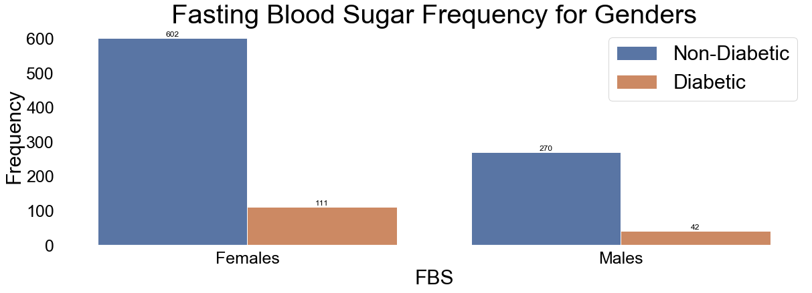
This bar graph shows the fasting blood sugar frequency for genders this contains the comparison of fasting blood sugar and frequency for males and females.
From this graph we can see that in females and males non-diabetic persons are more.
As we compare females have more diabetic patients as we compare with males .

Slide 13
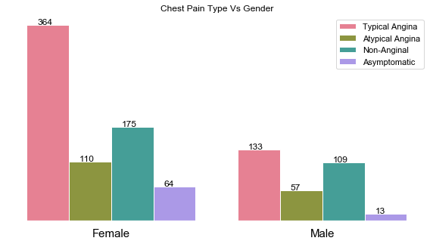
This shows that comparison of chest pain with gender.
As we see there are more female patients who are suffering with Typical Angina and Asymptomatic compared to men.
As we see there are more male patients who are suffering with Atypical Angina and Non-Anginal compared to women.

Slide 14
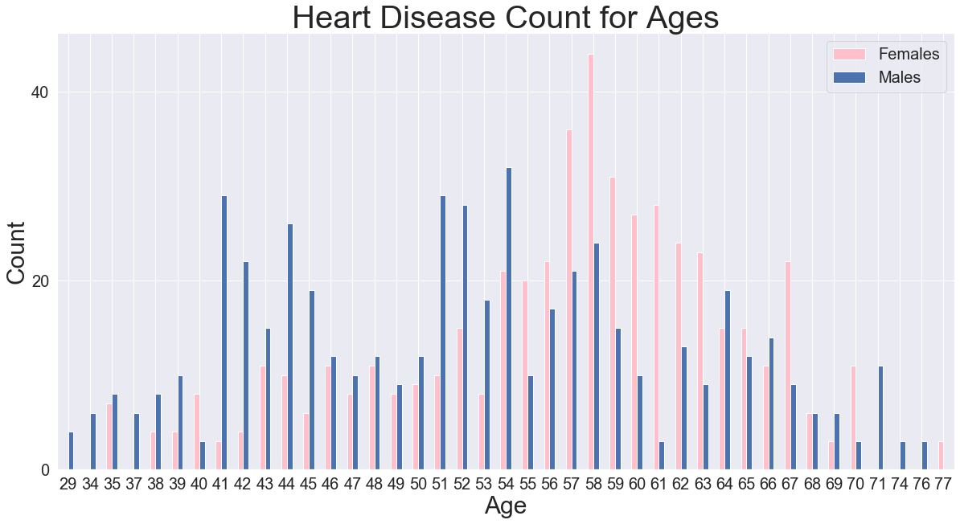
This graph compare the count of patients with their age .We see that most people who are suffering are suffering are of the age of 58followed by 57.Majorly people belonging to the age group of 50+ are suffering from the disease.We also see that the women from the age of 55 to 63 are suffering more as compared to men.From the age of 29 to 54 men suffers more as compared to men and then the age from 65 to 70 as compared to men majority women suffered with heart disease.

Slide 15
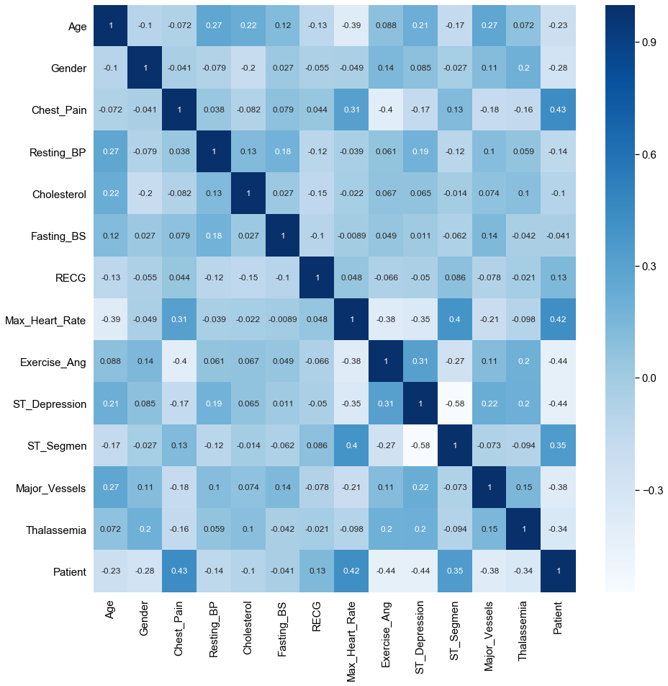
Correlation of the data

Slide 16
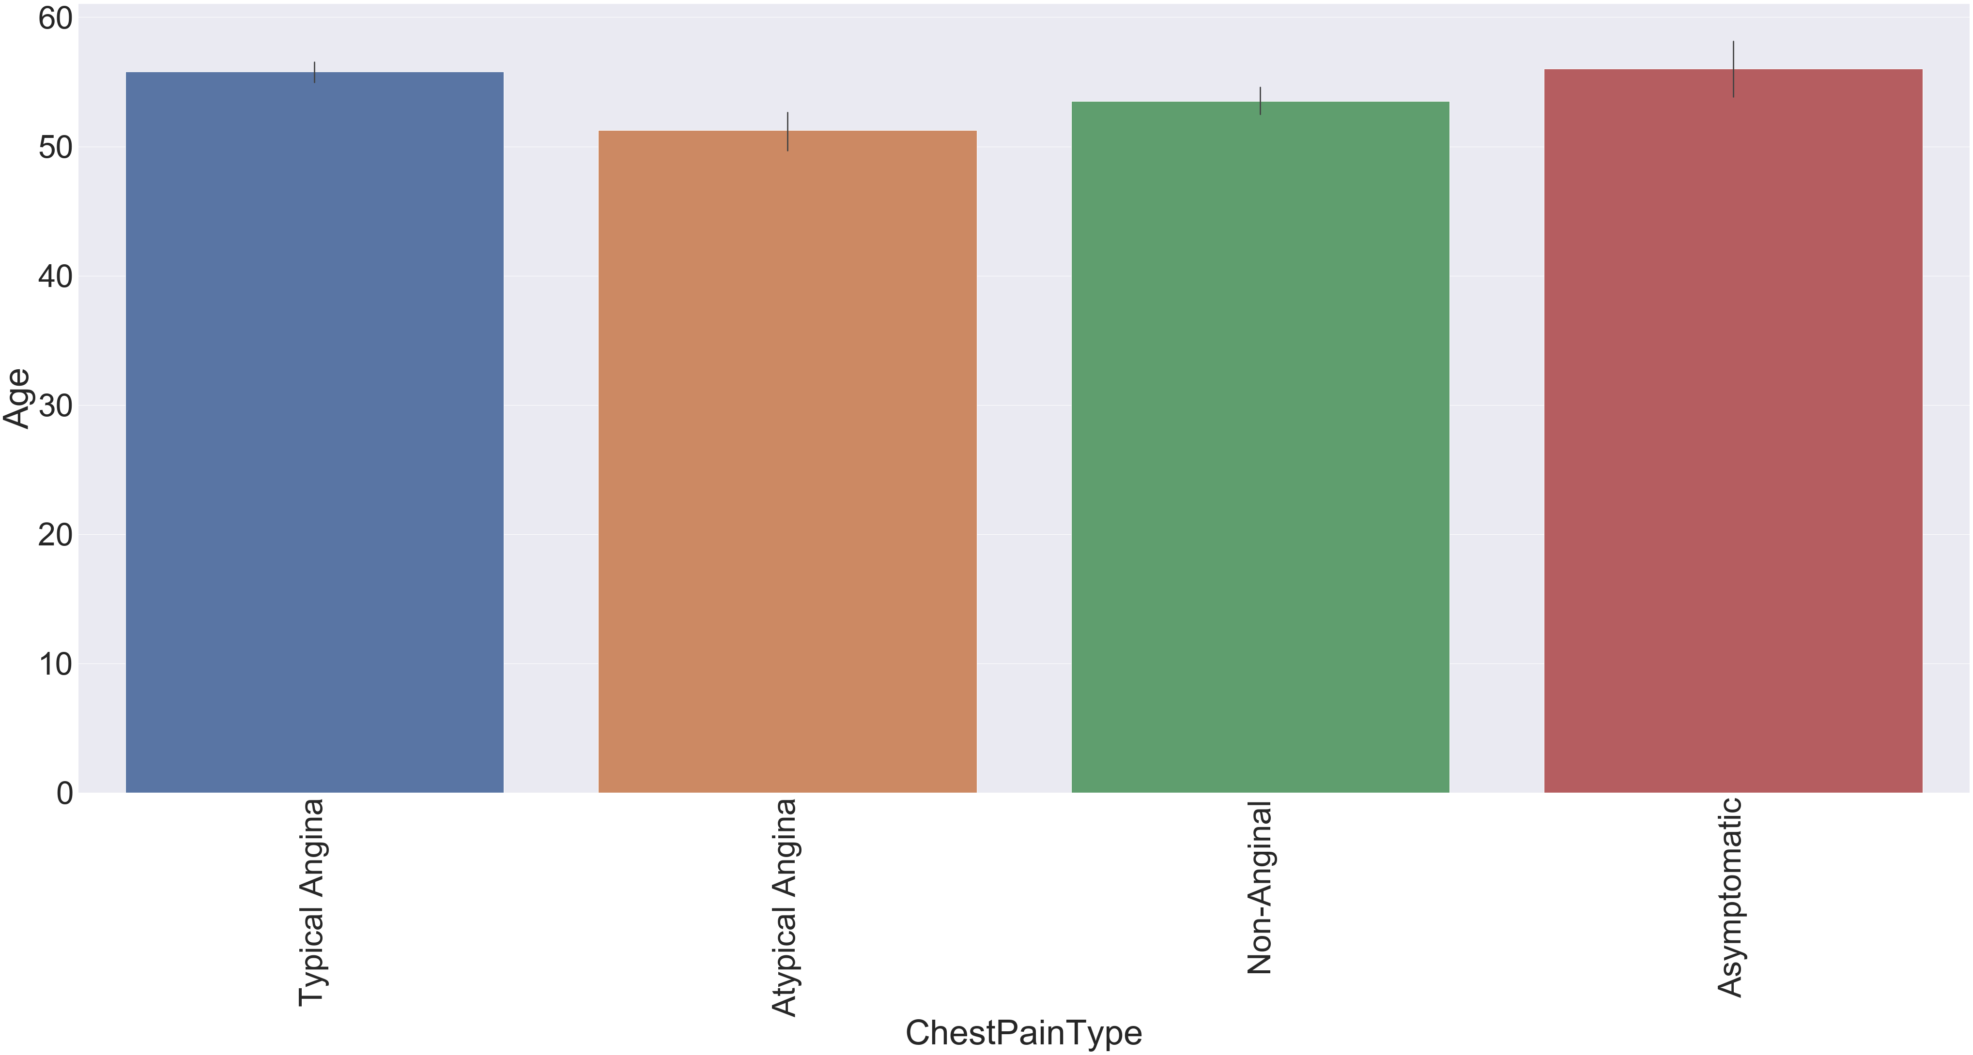
This graph compare the age and chest pain type of the patients.
As we can see that in between the age 50 to 60 there are most of Typical Angina and Asymptomatic patients.

Slide 17
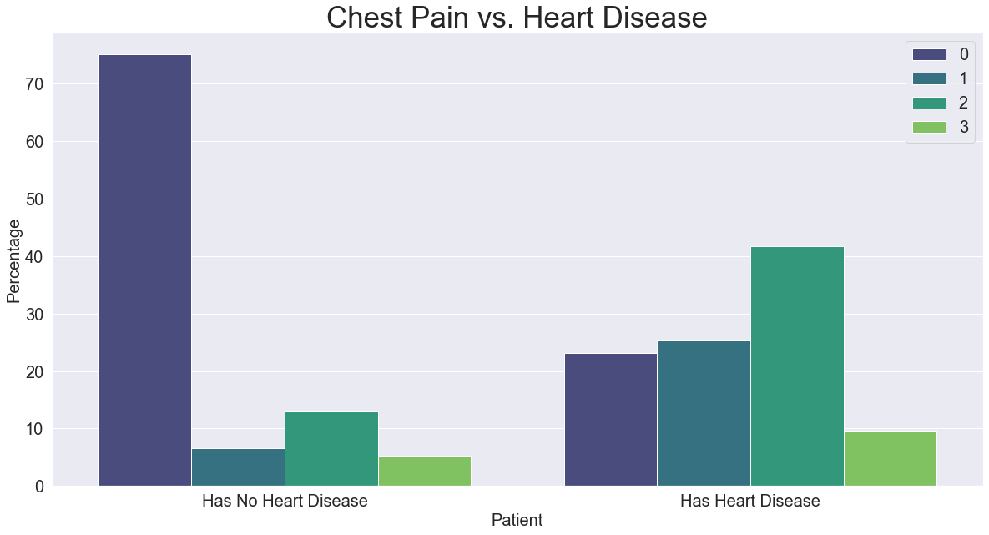
This graph shows the comparison for chest pain and heart disease .
0 = typical angina 1 = atypical angina 2 = non — anginal pain 3 = asymptotic
The patients with out heart disease are more suffering with typical angina as compared to heart disease patients.
The patients with heart disease are more suffering with atypical angina ,non-anginal pain and asymptotic diseases as compared to the patients with out heart disease.

Slide 18
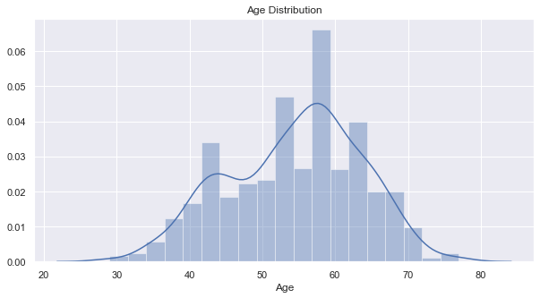

Slide 19
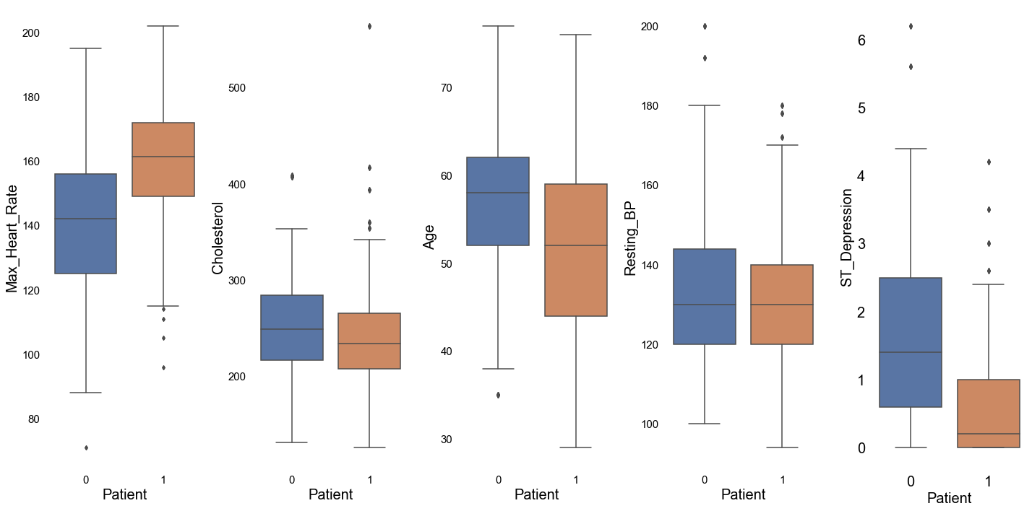

Slide 20
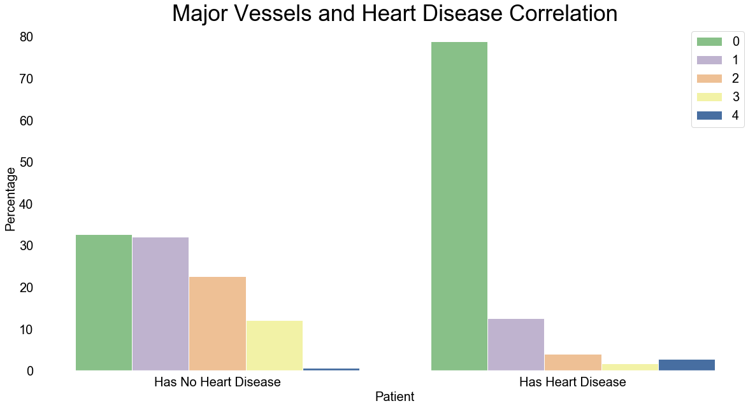

Slide 21
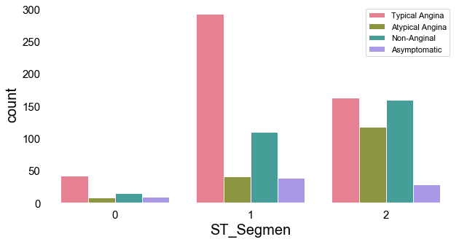

Slide 22
Conclusion and Future Work
Conclusion: This review offers the latest information on Big Data analytics in healthcare, predicting heart attack, and tailoring medical treatment to the individual. The results will guide providers, healthcare organizations, nurses, and other treatment providers in using Big Data technologies to predict and manage heart attack as well as what privacy concerns face the use of Big Data analytics in healthcare. Effective and tailored medical treatment can be developed using these technologies.

Slide 23
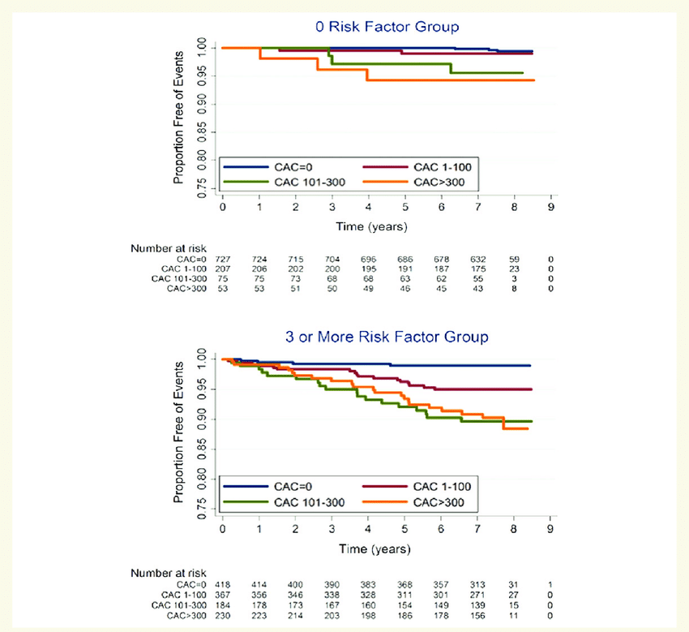

Slide 24
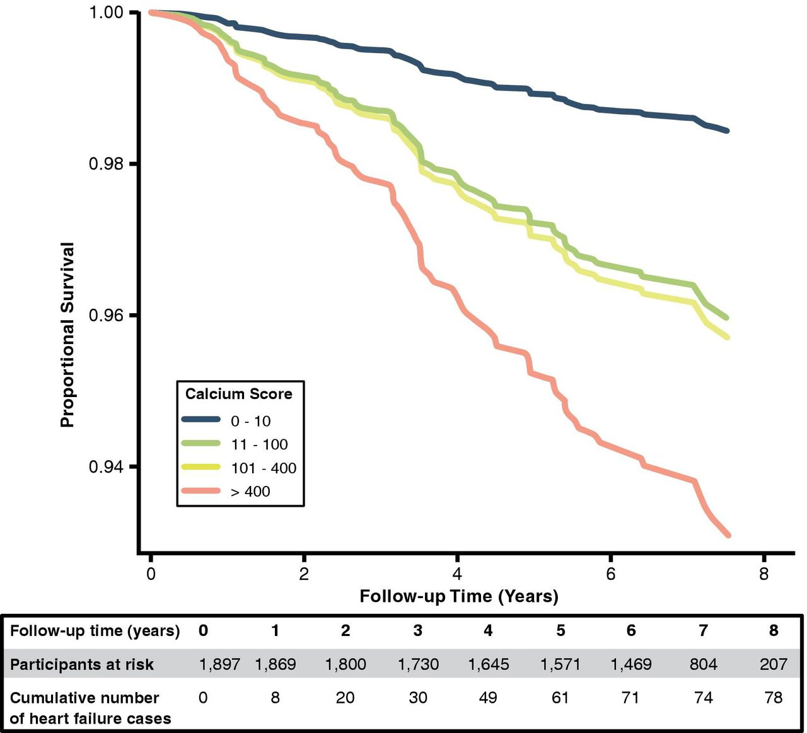

Slide 25
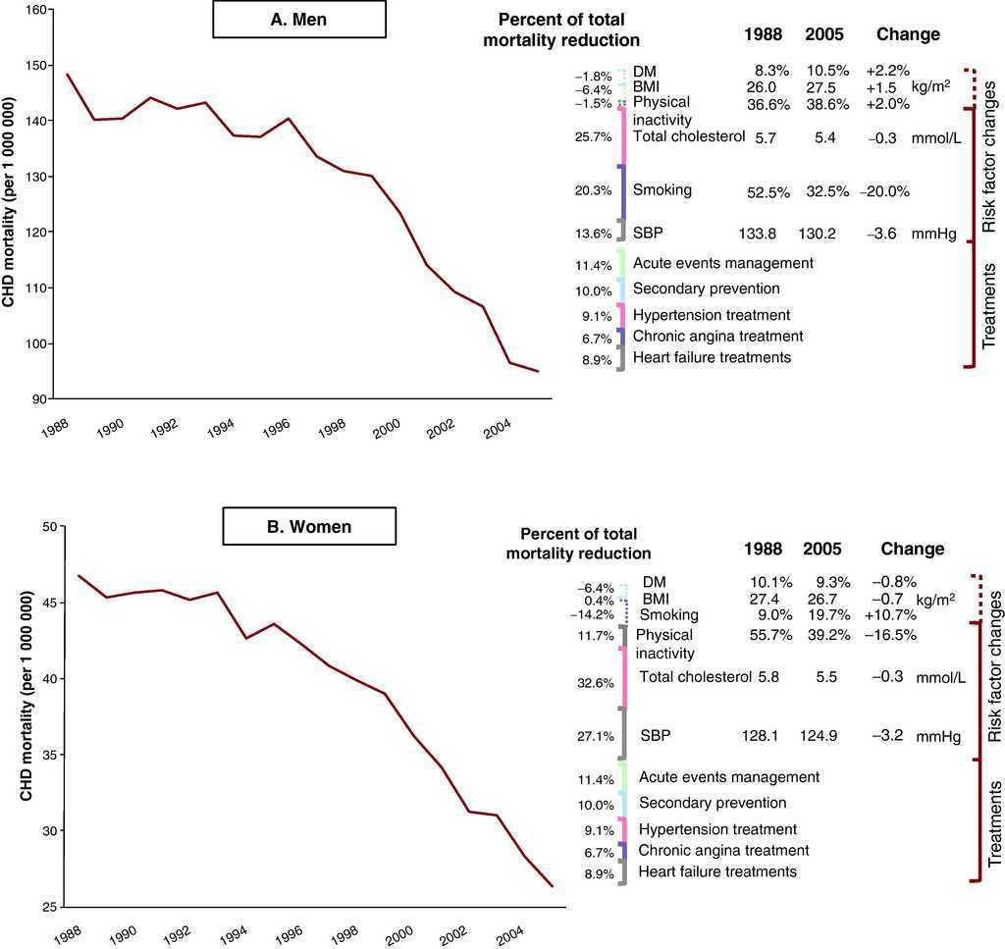

Slide 26
References
Catalog.data.gov
Kaggle.com
Data.world

